Slide 1
Chapter 3
Variables and Datatypes
Er. Amrit Poudel

Slide 2
Contents
Introduction to C language
A Basic C program
The compilation process
Character set
Comments
C tokens
Variable and constants4
Data types
Type Qualifiers
Operators and its types
Types of operators on the basis of number of operands
Precedence and Associativity of operators
Expressions
Header files
Format specifiers
Escape sequence character
Simple I/O functions
Type casting and conversion
Basic structure of C program

Slide 3
3.1 Introduction to C language
C is a high level language developed by Dennish Ritchie at Bell telephone lab, USA in 1972.
It is one of the most popular computer languages today because it is a structured high level, machine independent language.
It is both general purpose and specific purpose programming language.
It can develop small as well as complex programs.
It is well suited for writing both system software and business packages.
It is also called middle level language because it consists of assembly instructions.
UNIX is one example of an operating system that is developed using C programming language.

Slide 4
Features of C language
Well suited for both system and application software
C programs are efficient and fast.
Program written in one computer can run in another, hence portable.
Follows structural model
Has extendibility
Middle level language
Procedure oriented.

Slide 5
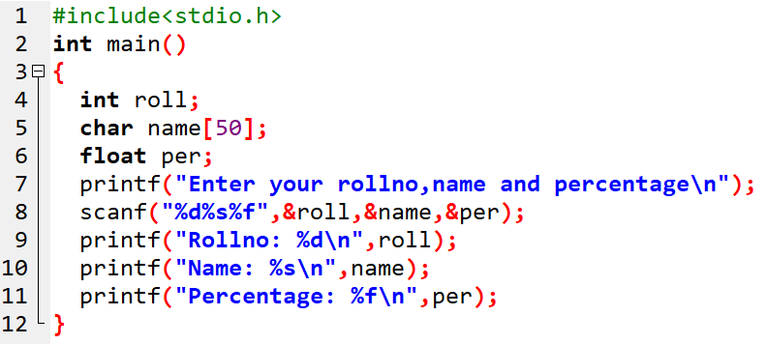
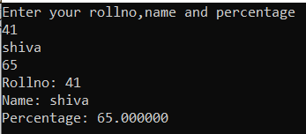
3.2 Basic C program

Slide 6
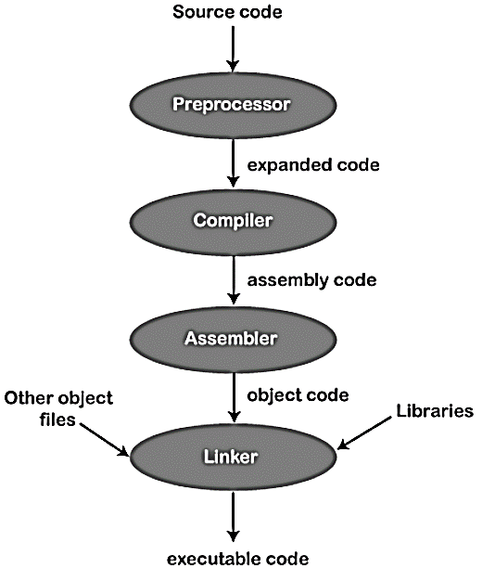
3.3 The Compilation process
The compilation is a process of converting the source code into object code.
It is done with the help of the compiler.
The compiler checks the source code for the syntactical or structural errors, and if the source code is error-free, then it generates the object code.
The compilation process can be divided into four steps:
Pre-processing
Compiling
Assembling, and
Linking

Slide 7
3.3 The Compilation process
The Preprocessor performs removal of comments and expansion of Macro and header files take place. This converts source code into expanded code (.i file)
The compiler converts this code into assembly code (.s file)
The assembly code is converted into object code (.obj file) by using an assembler.
A linker links all the parts of a program together and converts object code into executable code.

Slide 8
3.4 Character set
C has certain valid character sets.
A character denotes any alphabets, digits or special symbols.
The characters that are used in C-program are:
Alphabets : Upper case (A-Z) lower case (a-z)
Digits : 0-9
Symbols : + - * / # { } ( ) and so on.
White space : space, \t, \n, etc.

Slide 9

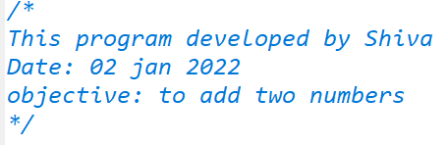
3.5 Comments
Used to put comment
Also used to block the line of code which should not be executed.
Two types:
Single line comment
Multiline comment

Slide 10
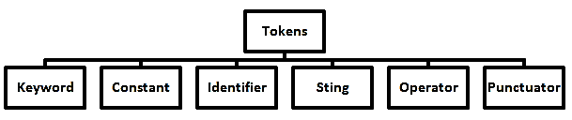
3.6 C-tokens
Token refers to smallest units of program which builds the entire program.
Six types of C-tokens.

Slide 11
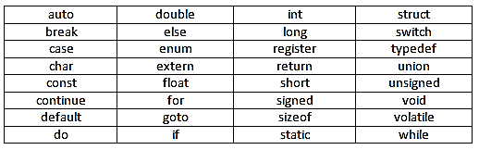
1. Keyword
Reserved words
Have their own meaning in programs.
Keywords cannot be used for naming variables or identifiers.
32 keywords

Slide 12
2. Identifiers
Names given by programmers for :
Variables, Constants, Array, Functions, Structures
Rules for naming variables
Identifier name should begin with an alphabet or underscore.
Name can include alphabets, digits and underscore only.
Keywords cannot be used for naming
Uppercase and lowercase letters are different to each other.
Only 31 characters are valid.
Which are valid?
int roll;
int Roll;
int _roll;
int float;
int num;
float num_first;
double _firstnum;

Slide 13
3. Constant
Memory location that store fixed values.
Declare with const keyword

Slide 14
4. String
String is sequence of characters that are enclosed in double quotation marks (“ ”).
Eg: char name[ ]= “Mahesh”;
Here “Mahesh” is a string.

Slide 15
5. Operators
Operators are various symbols that are used for calculation of manipulation of data.
Eg: x = a + b;
Here = and + are operators. x,a,b are operands.

Slide 16
6. Punctuators
Punctuators are the special characters like
[], (). {}, : , #, etc.
that define special task to be carried out by the compiler.

Slide 17
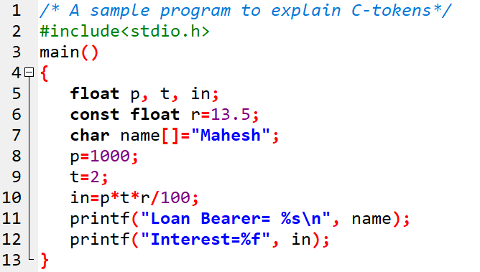
Sample program
Here, in the above program:
Keywords | float, const, return, char
Identifiers | p, t, in, name
Constants | r
Strings | Mahesh
Punctuators | [] () {} ; , “ ” \ %
Operators | = + *

Slide 18
3.7 Variables
Memory location that stores value that are changeable
Syntax: DataType VariableName1, VariableName 2, …. ;
Eg: int num1;
int num1, num2;
float avg;
Rules for writing Variable names:
Must begin with an alphabet or underscore
It can be of alphabets or alphanumeric.
The uppercase and lowercase letters are distinct/different, hence cannot be interchangeable. Eg; Total is not same as total.
Only 31 characters are significant.
It must not contain white space (blank) in between. But underscore(_) is accepted to join.
The keywords are not allowed as variable names.

Slide 19
3.7 Constants
Memory location that stores fixed value.
Constant value cannot be altered in the program.
Syntax: const DataType identifier= value;
Eg: const float PI = 3.14;
Here, PI is a constant.
Also can be defined as:
# define PI 3.14

Slide 20
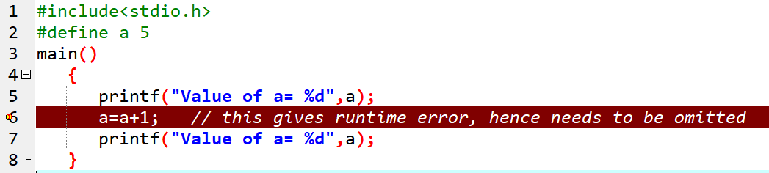
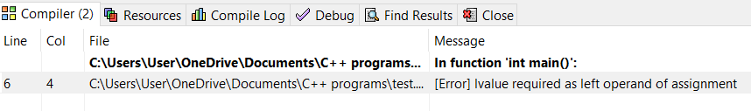
Sample program 3.3

Slide 21
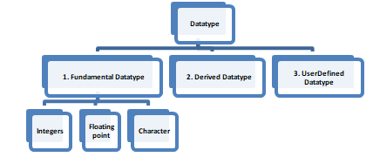
3.8 Data-types
A datatype refers to the type of data that can be stored in a variable.

Slide 22
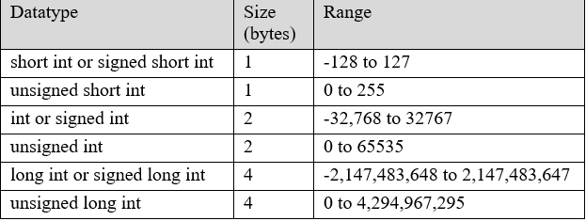

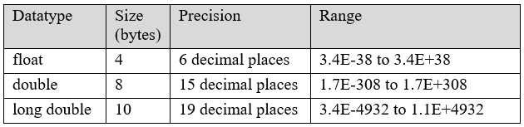
1. Fundamental datatype
Basic datatypes: integer, floating point and character
i) Integer Datatype
iii) Character Datatype
ii) Floating point
Datatype

Slide 23
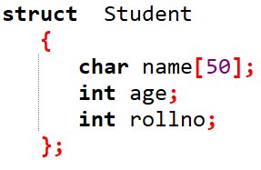
2. Derived datatype
Created using fundamental datatypes
Arrays, functions, structures, unions and pointers.
Here, Student is a derived datatype.

Slide 24
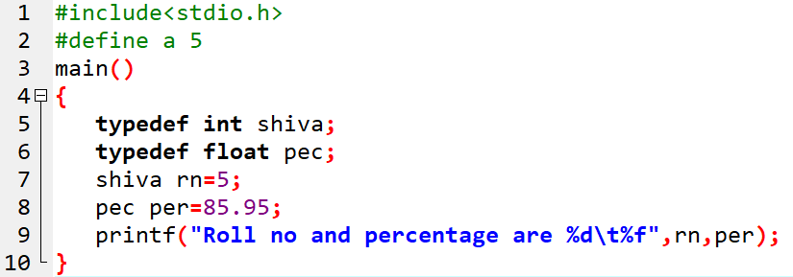
3. User-defined datatype
Defined by user for their simplicity.
Done by using typedef or enum keywords.

Slide 25
3.9 Type qualifiers
Used to modify the property of a variable.
Keywords applied to datatypes.
Two qualifiers: const and volatile.
Const used to create constant.
Volatile used to create variables whose values cannot be changed explicitly in the program, but can be changed by any external device or hardware. System’s clock is volatile variable.

Slide 26
3.10 Operators
An operator is a symbol that tells the compiler to perform a certain mathematical or logical manipulation.
Operators are used in programs to manipulate data and variables.
Eg: sm= a+b;
Here, + and = are operators and sm, a and b are operands.

Slide 27
3.10 Operators
Types of operator | Symbols used
Arithmetic | + - * / %
Relational | < > <= >= == !=
Logical | && || !
Assignment | = += -= *= /= %=
Increment/decrement | ++ --
Conditional | ? :
Bitwise | & | ^ << >>
Special | & * sizeof()

Slide 28
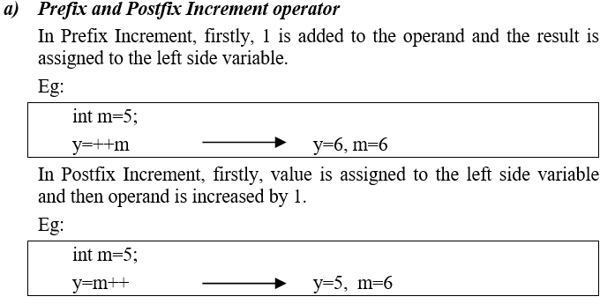
Increment and Decrement Operator

Slide 29
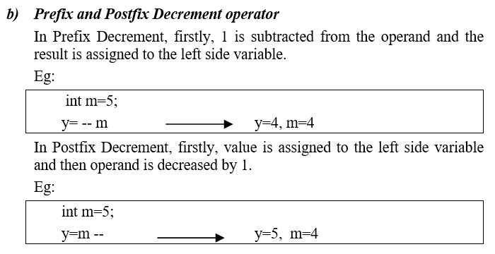
Increment and Decrement Operator (Contd.)

Slide 30
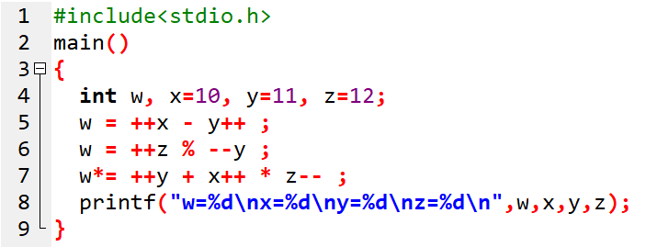
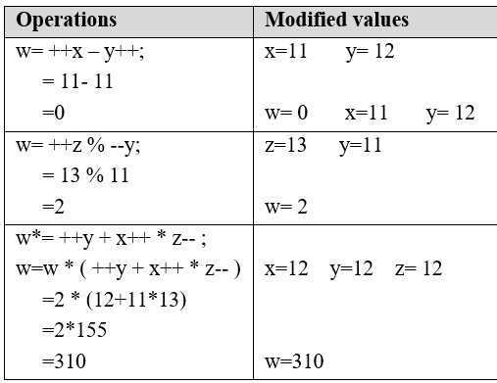
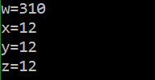
Increment and Decrement Operator (Contd.)
Find the output of below:
Working note:
Output:

Slide 31
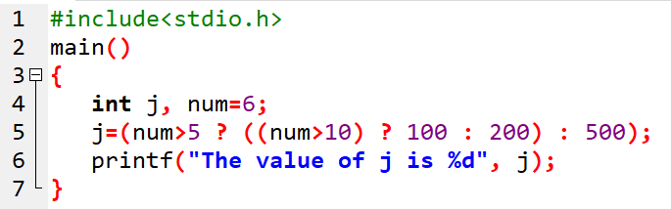

Conditional operator
What will be the output of below program?
Output

Slide 32
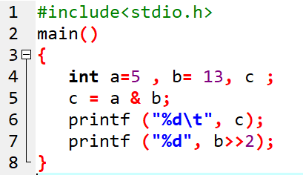
Bitwise operator
What will be the output of below program?
Output:

Slide 33
3.11 Types of operators
On the basis of number of operands:
Types | Examples
Unary | a++ a+=1
Binary | X= a+b if (a>b)
Ternary | x = (num> 0 ?”Positive” : “Negative”

Slide 34
3.12 Precedence and Associativity of operators
Precedence : which operator to evaluate first
Associativity: which one to operate first when having same precedence
Category | Operator | Associativity
Postfix | () [] -> . ++ - - | Left to right
Unary | ! ~ + - ++ - - & * sizeof (type) | Right to left
Arithmetic | * / % + - | Left to right
Shift operators | << >> | Left to right
Relational | < <= > >= == != | Left to right
Bitwise operators | & ^ | | Left to right
Logical operators | && || | Left to right
Conditional | ?: | Right to left
Assignment | = *= /= %= += -= &= ^= |= <<= >>= | Right to left

Slide 35
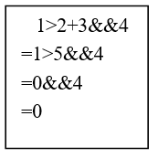
Evaluate: 1>2+3&&4
Solution

Slide 36
3.13 Expressions
An expression statement consists of an expression followed by a semicolon.
For e.g:
sum=x+y; //simple expression
x= (4*PI*pow(r,3))/3; //complex expression

Slide 37
3.14 Header files
S.no. | Header files | Purpose
1 | stdio.h | Used for performing Input/Output operations
2 | string.h | Used for string manipulation
3 | math.h | Handles mathematical functions
4 | stdlib.h | For general utilities like memory management, string handling, etc.
5 | conio.h | For Console Input/Output
6 | graphics.h | For using graphics in the program
A Header file is a standard file that contains definitions of variable and functions that are necessary for the functioning of a program.
We use #include directive to import header files

Slide 38
3.15 Format specifiers
characters starting with % sign
Tells compiler what type of data to take.
S.No. | Datatype | Format Specifier
1. | int or short int | %d or %i
2. | long int | %ld
3. | unsigned int | %u
4. | unsigned long int | %lu
5. | float | %f
6. | double | %lf
7. | long double | %Lf
8. | char | %c
9. | string | %s

Slide 39
3.16 Escape Sequence Characters
Escape Sequence | Meaning
\a | Alarm or Beep
\b | Backspace
\n | New Line
\t | Tab (Horizontal)
\v | Vertical Tab
\\ | Backslash
\' | Single Quote
\" | Double Quote
\? | Question Mark
\0 | Null
starts with backslash \.
Have some special meaning

Slide 40
3.17 Simple I/O Functions
Functions used for input and output operations
scanf() : used to get input from user and store in variable
printf() : to display message or output.

Slide 41
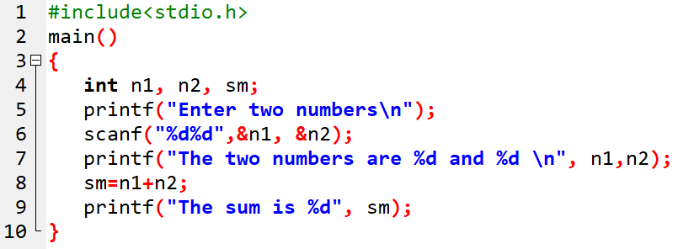
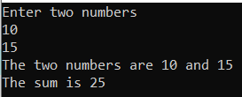
Sample program
Header file
Hea
variables
Escape sequence characters
Operator
Format Specifiers

Slide 42
3.18 Type Casting (Contd.)
Technique of changing one datatype into another type.
Two types:
Implicit conversion
Explicit conversion

Slide 43
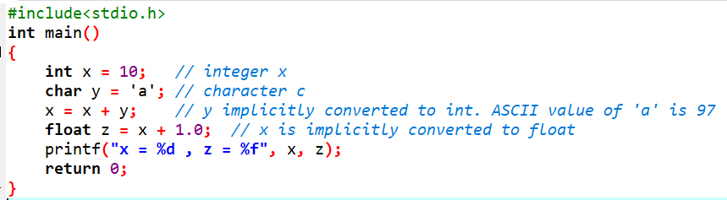

3.18 Type Casting (Contd.)
Technique of changing one datatype into another type.
Two types:
Implicit conversion
Explicit conversion

Slide 44
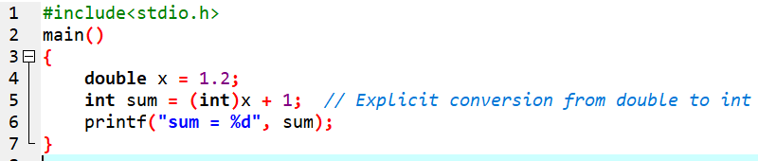

3.18 Type Casting (Contd.)

Slide 45
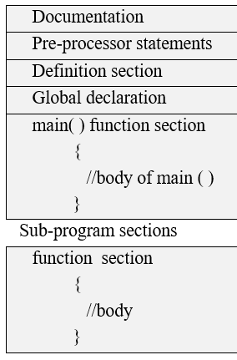
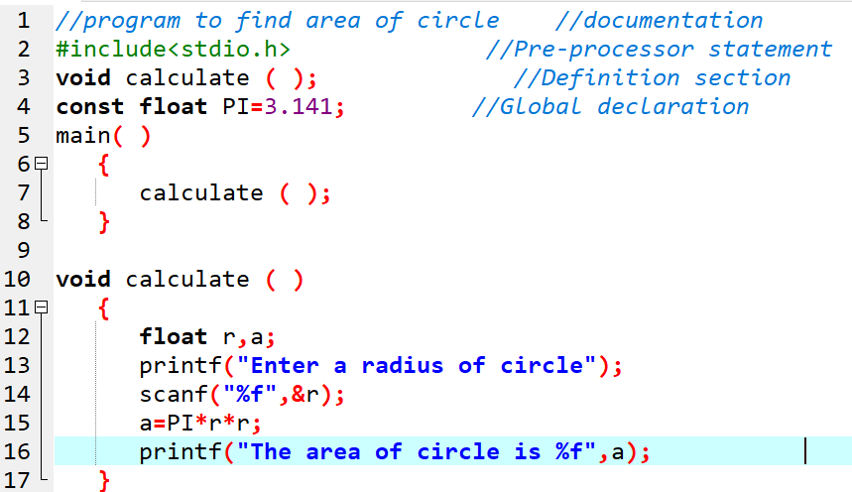
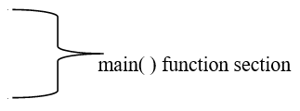
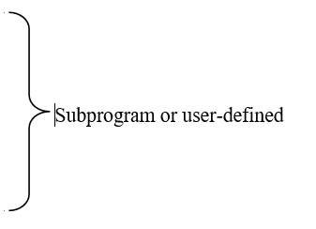
3.19 Basic Structure of C program

Slide 46

3.20 Some Sample Programs

Slide 47
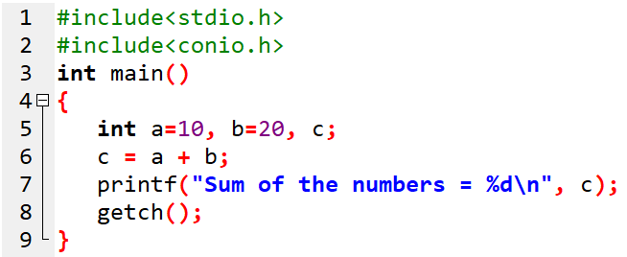
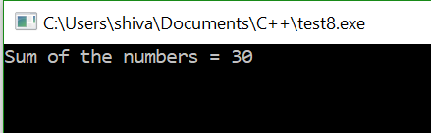
1. WAP to read two numbers and add them.

Slide 48
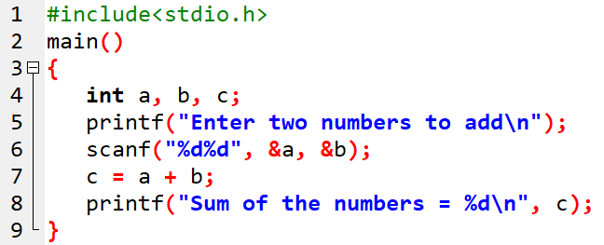
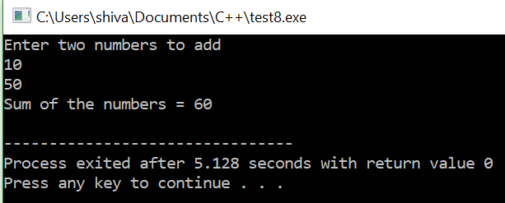
2. WAP to accept two numbers form user and find their sum.

Slide 49
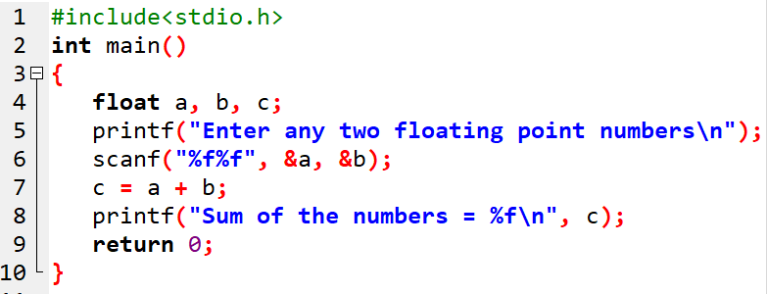
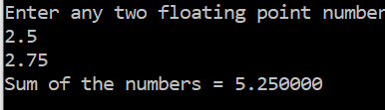
3. WAP to enter any two decimal numbers and find their sum.

Slide 50
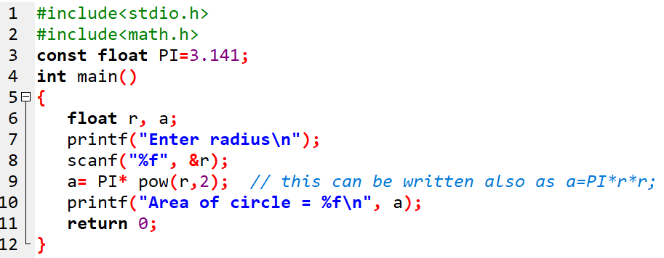
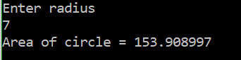
4. WAP to enter radius and find the area of circle.

Slide 51
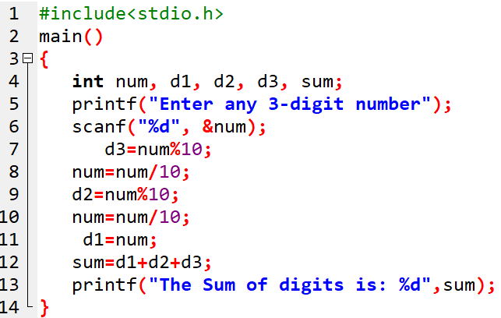
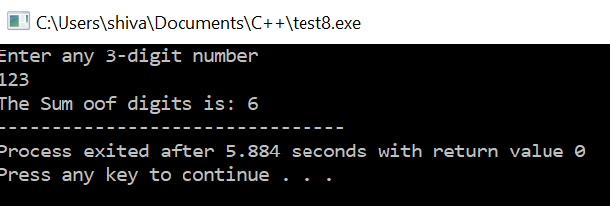
5. WAP to enter any 3-digit integer and find the sum of individual digits in it.

Slide 52
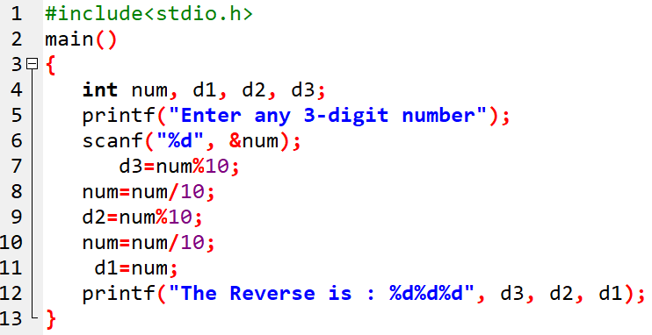
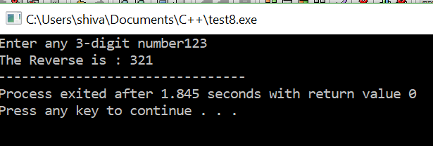
6. WAP to enter any 3-digit integer and display it in reverse order.

Slide 53
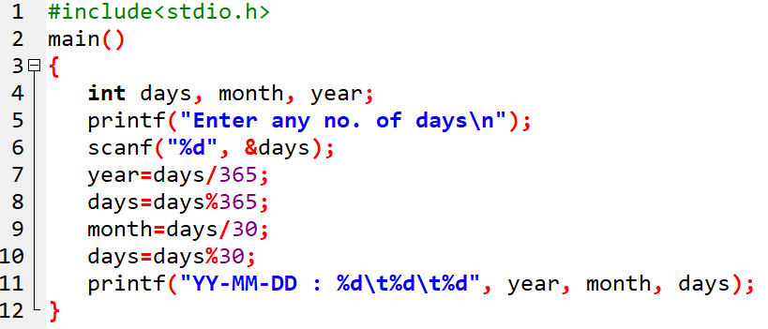
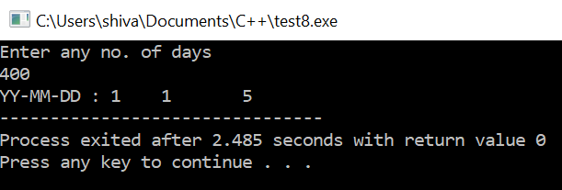
7. WAP to ask no. of days and then change it into years, month and days.

Slide 54
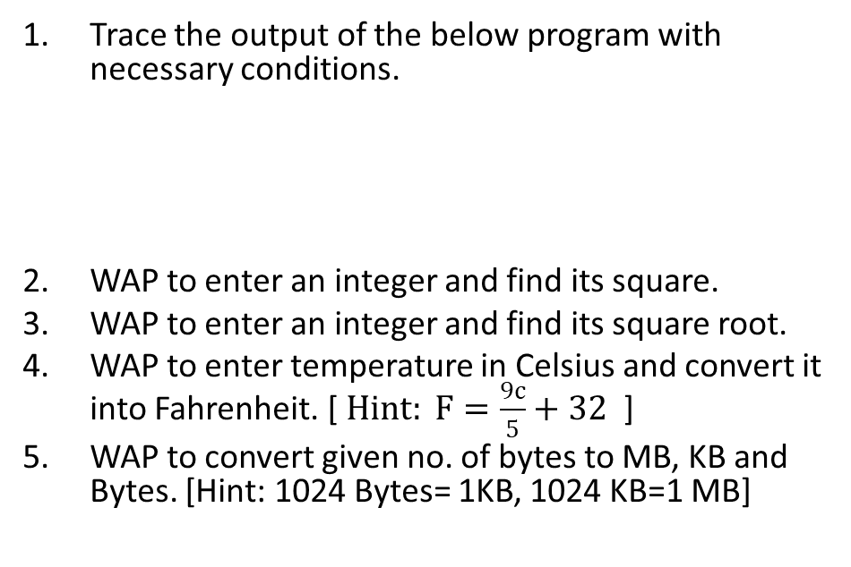
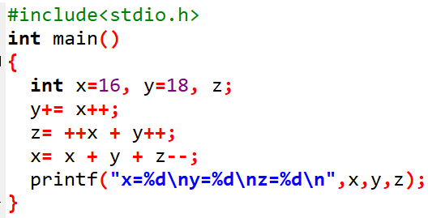
Assignment:

Slide 55
End of Chapter

